Slide 1
LG BOOST REGRESSOR

Slide 2
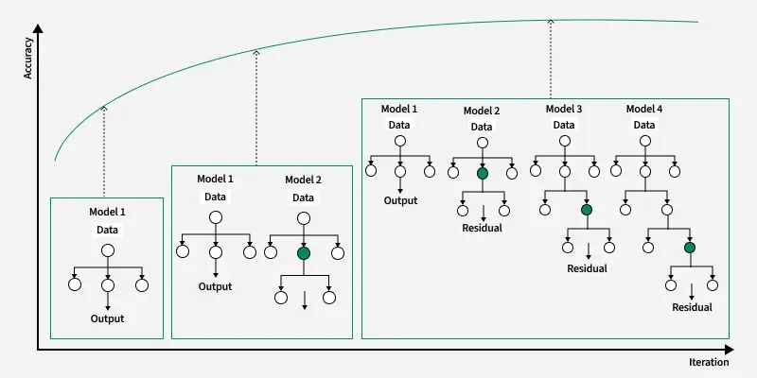

Slide 3
Gradient Boosting
Gradient Boosting is an ensemble machine learning technique that builds a series of decision trees.
Each decision trees aimed at correcting the errors of the previous ones.
Unlike AdaBoost, which uses shallow trees, Gradient Boosting uses deeper trees as its weak learners.
Each new tree focuses on minimizing the residual errors — the differences between actual and predicted values — rather than learning directly from the original targets.

Slide 4
PROCESS
Starts with an initial baseline prediction - the average value of the target
Calculates the residuals of the predictions.
Trains a new model specifically to predict these residuals.
Adds the new model's predictions to the previous ones to reduce the overall error.

Slide 5
Thank You!

